Slide 1

Chapter - 5
MANAGING INPUT AND OUTPUT OPERATIONS
By :- Henil Patel

Slide 2
The Role of I/O in C Programming
  All computer programs are built around three essential functions: Reading Data (Input), Processing Data, and Writing Data (Output).
  In C, unlike many other high-level languages, I/O operations are not built into the language syntax itself. Instead, they are handled entirely by function calls found in the Standard I/O Library.
  To use any of these I/O functions, every C program must include the Standard Input/Output Header File:
#include <stdio.h>

Slide 3
UNFORMATTED CHARACTER I/O
Unformatted I/O deals with reading or writing single, raw characters without attempting to interpret them as numbers, strings, or other structured data.
1. Reading a Single Character
  Function: getchar()
  Purpose: Reads the next single character available from the standard input (usually the keyboard).
  Syntax: variable_name = getchar();
  Requirement: The receiving variable (variable_name) must be of type char.
  Important Warning: getchar() reads any character, including invisible ones like RETURN (\n) and TAB. In loops, the residual newline character can cause unexpected behavior, often requiring a dummy getchar() call to consume the unwanted character.

Slide 4
2. Writing a Single Character
  Function: putchar()
  Purpose: Writes a single character to the standard output (usually the terminal screen).
  Syntax: putchar(variable_name); or putchar('constant');
Usage: It's used for displaying variable characters, constant characters (e.g., putchar('A');), or for cursor control (e.g., putchar('\n'); for a newline).

Slide 5
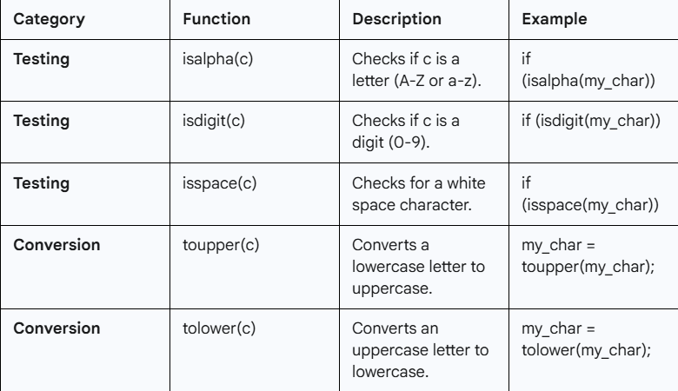
CHARACTER TESTING AND CONVERSION

Slide 6
FORMATTED INPUT
Formatted Input refers to reading data that is expected to be arranged in a specific, structured format (like reading a number followed by a name).
  Function: scanf (Scan Formatted)
  General Form: scanf ("control string", &arg1, &arg2, ...);
Crucial Rule: The Address Operator (&)
Every argument in a scanf call (except for string arrays, which are already addresses/pointers) must be preceded by the address operator (&) (e.g., &num). This operator provides the function with the variable's memory location where the scanned value should be stored.

Slide 7
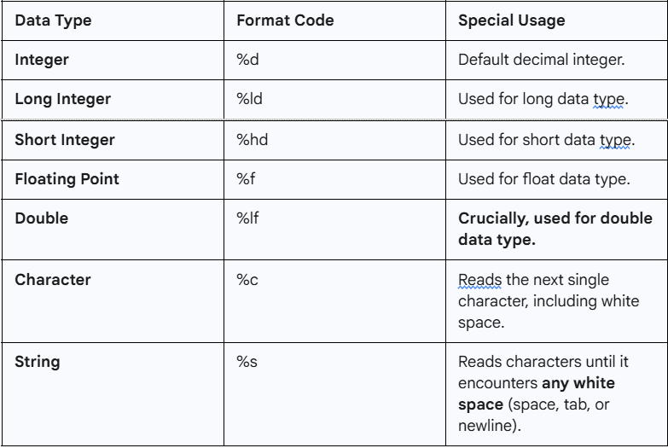
INPUT SPECIFICATIONS (FORMAT CODES)

Slide 8
Reading Strings with Spaces
Since %s terminates reading at a space, you must use Scan Sets to read strings containing internal white space (like an address or a full name):
  Form: scanf("%[^characters]", address);
  Example: scanf("%[^\n]", my_address);
This instructs scanf to read all characters (%[...]) except (^) the newline character (\n), allowing it to capture the entire line.
Error Detection
The scanf() function returns an integer value representing the number of items successfully read and assigned. If a data type mismatch occurs (e.g., reading a letter when expecting %d), scanf stops immediately, and the return value will be less than the number of arguments provided.

Slide 9
FORMATTED OUTPUT (PRINTF())
Formatted Output allows you to display data on the standard output (screen) with precise control over its appearance, alignment, and precision.
  Function: printf (Print Formatted)
  General Form: printf("control string", arg1, arg2, ...);
The control string is a powerful combination of three things:
  Characters: Printed directly as they appear (e.g., "Result: ").
  Escape Sequences: Special characters like \n (newline) and \t (tab).
  Format Specifications: Placeholders (starting with %) for displaying the argument values.

Slide 10
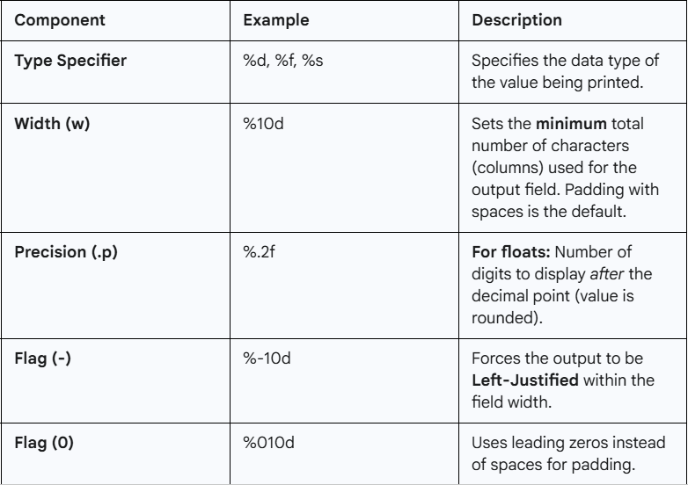
THE OUTPUT SPECIFICATION STRUCTURE

Slide 11
OUTPUT OF REAL NUMBERS
  Decimal Format: %w.p f
  Example: printf("%10.2f", 98.7654); would output the number right-justified in 10 columns, rounded to two decimal places (e.g., 98.77).
Exponential Format: %w.p e
Output of Characters and Strings
  String Truncation: For strings, the precision .p acts as a maximum number of characters to display.
  Example: printf("%.5s", "Programming"); would output only Progr.

Slide 12
THANK YOU

